Slide 1

Iris Flower Example
Professor Bo Liu
James Watt School of Engineering

Slide 2
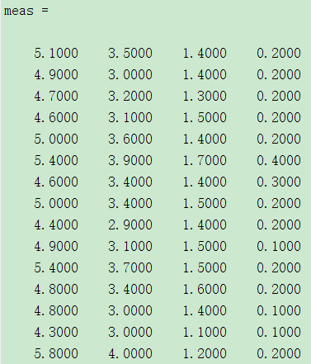
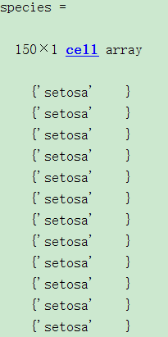
Iris flower classification with hard margin classifier
1. Load the data
% Load the iris dataset
load fisheriris
measurements of the 4 features
labels
2. Exact two features and two species so that the dataset is linearly separable
% Extract two features and two species
X_train = meas(1:80, 1:2); y_train = species(1:80); % The first 80 samples are training set
X_test = meas(81:100, 1:2); y_test = species(81:100); % The subsequent 20 samples are test set
See live script

Slide 3
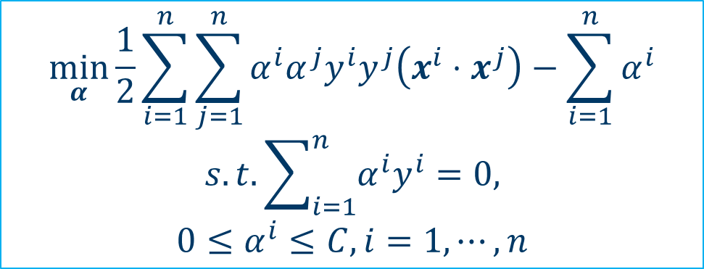

Iris flower classification with hard margin classifier
3. Train an SVM hard margin classifier
% Train a hard margin SVM classifier
svm = fitcsvm(X_train, y_train, 'KernelFunction', 'linear', 'BoxConstraint', Inf);
$$\min_{α}{\frac{1}{2}}\sum_{i=1}^{n}{\sum_{j=1}^{n}{α^{i}α^{j}y^{i}y^{j}\left(x^{i}⋅x^{j}\right)−\sum_{i=1}^{n}{α^{i}}}}$$
$$s.t.\sum_{i=1}^{n}{α^{i}y^{i}}=0,$$
$$0≤α^{i}≤C, i=1,⋯,n$$
BoxConstraint represents $C$.
BoxConstraint controls the tradeoff between margin violation and margins
  Large BoxConstraint, prefer a small margin violation
  Small BoxConstraint, prefer large margins
  Setting BoxConstraint = Inf means we train a hard margin classifier.
See live script

Slide 4
Iris flower classification with hard margin classifier
4. Predict
% Predict
y_pred = predict(svm, X_test);
5. Calculate the prediction accuracy
% Count the number of correct classified samples.
num_correct = 0;
for i = 1: length(y_test)
num_correct = num_correct + strcmp(y_pred(i), y_test(i));
end
% Calculate the prediction accuracy
accuracy = num_correct/length(y_test)*100;
disp(['Accuracy= ', num2str(accuracy)]);
We will get ‘Accuracy=100’ in this example.
See live script

Slide 5
Iris flower classification with hard margin classifier
Plot and visualize the results (optional)
1. Get the support vectors and classifier coefficients
sv = svm.SupportVectors; % Get the support vectors
beta = svm.Beta; % Get the coefficients of the linear classifier
b = svm.Bias; % Get the bias term of the linear classifier
2. Plot the dataset and support vectors
gscatter(X(:,1), X(:,2), y, 'rb', 'so'); hold on; % Plot the dataset
plot(sv(:,1), sv(:,2), 'ko', 'MarkerSize', 10); hold on; % Plot the support vectors
3. The equation of the linear classifier
% The classifier
X1 = linspace(min(X_train(:,1)),max(X_train(:,1)),100); % Data points of x-axis
X2 = -(beta(1)/beta(2)*X1)-b/beta(2); % The equation of the classifier
plot(X1,X2,'-'); hold on; % Plot the classifier
See live script

Slide 6
Iris flower classification with hard margin classifier
4. The equations of the margin boundaries
% The equations two margin boundaries
bnd1 = -(beta(1)/beta(2)*X1)-b/beta(2) + 1/beta(2);
bnd2 = -(beta(1)/beta(2)*X1)-b/beta(2) - 1/beta(2);
5. Plot the margin boundaries
% Plot the two margin boundaries
plot(X1,bnd1,'k-.'); hold on;
plot(X1,bnd2,'k-.'); hold on;
6. Add the labels and legend
% axes labels and legend
xlabel('Sepal Length', 'Fontsize', 14);
ylabel('Sepal Width', 'Fontsize', 14);
legend('setosa', 'virginica', 'Support Vector', 'Separating Hyperplane', 'Margin Boundaries', 'Fontsize', 14)
hold off;
See live script

Slide 7
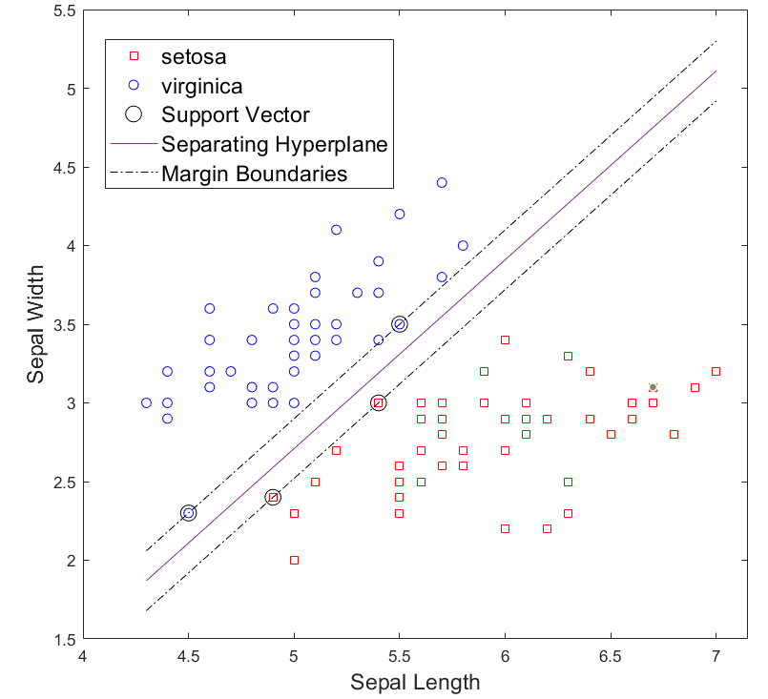
Iris flower classification with hard margin classifier
The results
See live script

Slide 8
Iris flower classification with soft margin classifier
The margin of the hard margin classifier is small, which may lead to low generalization.
For better generalization, we can train a soft margin classifier even through the dataset is linear separable.
To train a soft margin SVM, just modify the parameter ‘BoxConstraint’ to a smaller value (e.g., 1):
% Train an SVM classifier
svm = fitcsvm(X_train, y_train, 'KernelFunction', 'linear', 'BoxConstraint’, 1);
See live script

Slide 9
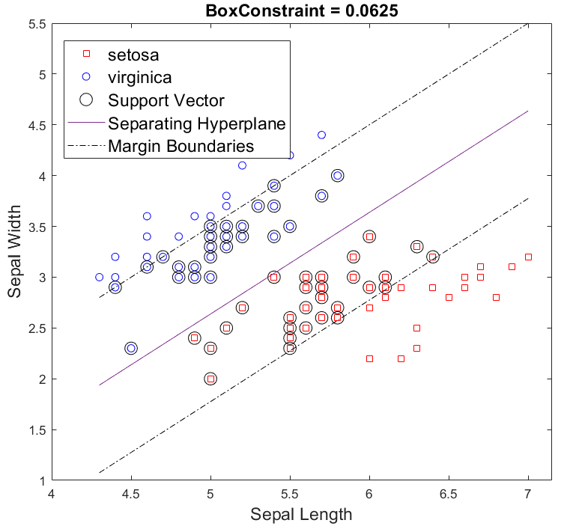
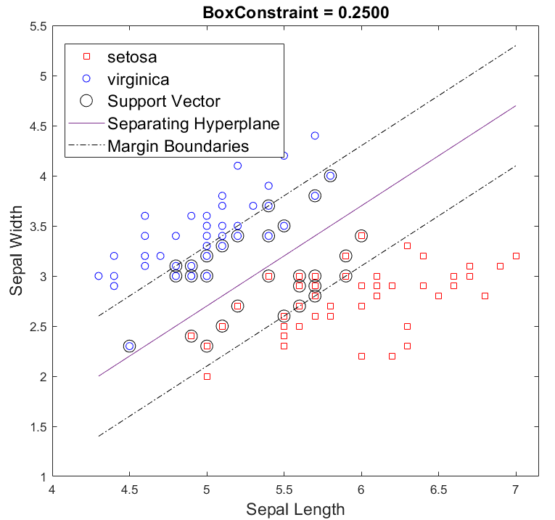
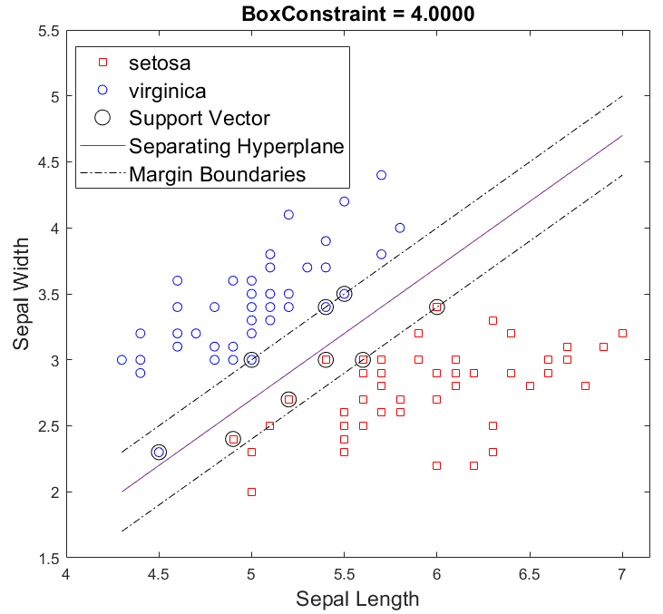
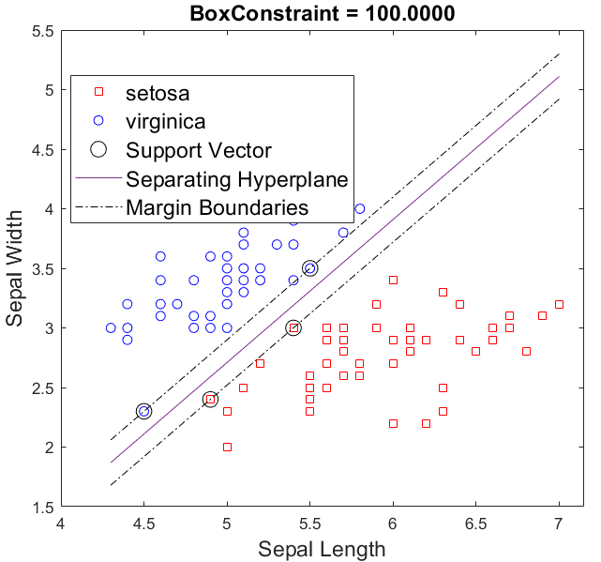
Iris flower classification with soft margin classifier
See live script

Slide 10
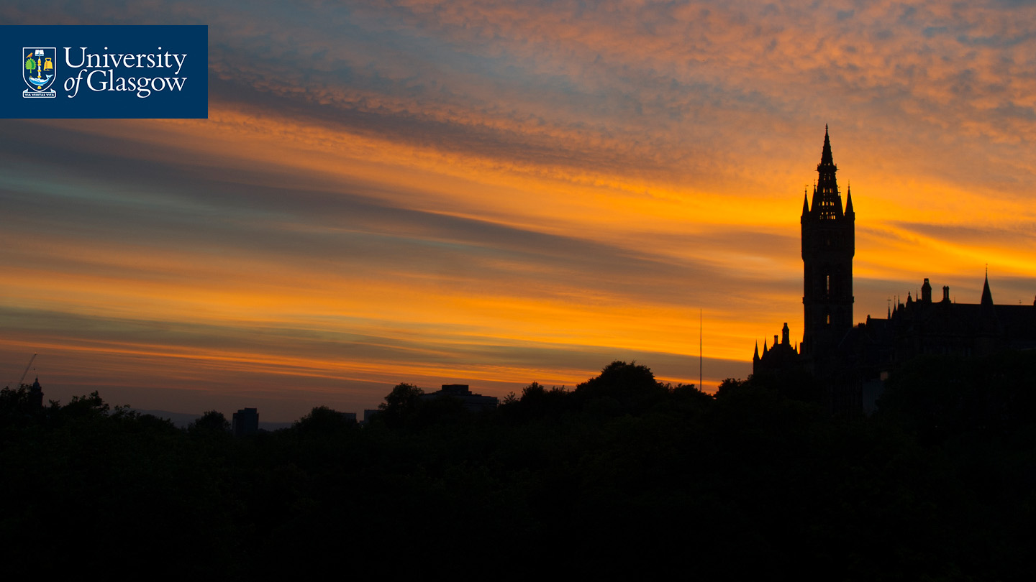



Thanks!
#UofGWorldChangers
@UofGlasgow

